Slide 1
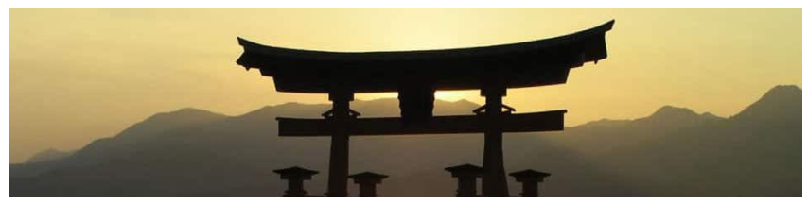
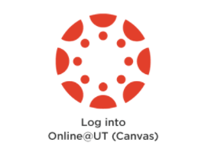
Design Project Prototype
Tutorial for the Tennessee Area Japanese Speech Contest
Project Design for The University of Tennessee Knoxville
Department of MFLL, Japanese Program
Designed by Hongyan Yang, Keiko Eda
Learner Audience: Students taking JAPA352 and have more than two and half years of experience learning the Japanese language. Students aiming to participate in the Contest.
Project Stakeholders: UTK Japanese Language Program Faculty, Department head, College head, and Tennessee Japanese Speech Contest Executive Committee.
Project Goal: The tutorial for the Tennessee area Japanese Speech Contest will provide learners with knowledge and skills about developing and delivering an effective speech in Japanese for the Contest and future work fields. Learners will gain confidence and motivation for future language learning and work.
Performance and Learning Context: Learners who have achieved each milestone in this project will apply to the Tennessee Area Japanese Speech Contest at the end. Learners will videotape their speeches to participate in the Contest. The speech will be judged by a native Japanese speaker invited by the speech contest executive committee, and the learners will be notified of the results. However, the possible performance sites are not limited to this scenario. After the Contest, learners may use the knowledge and skills gained through the project to give speeches and presentations in Japanese as their second language at various sites such as educational institutions, businesses, the military, and government agencies.
テネシー州日本語スピーチコンテスト

Slide 2
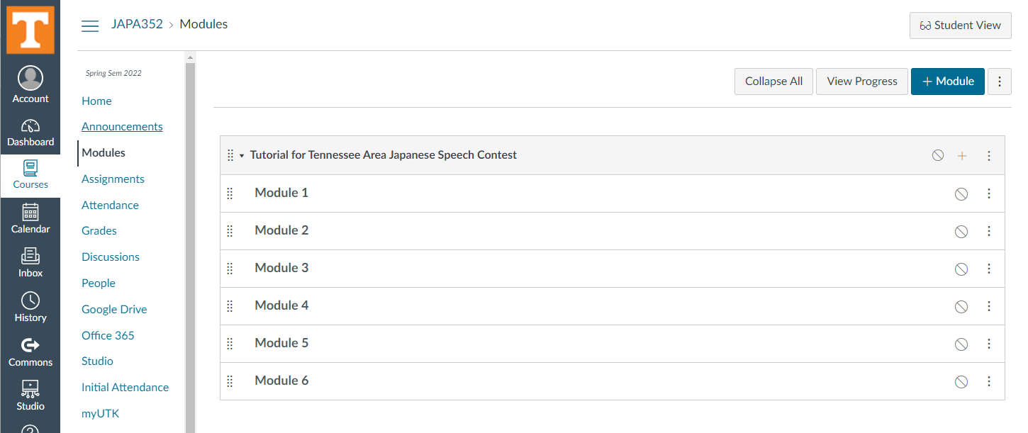

Slide 3
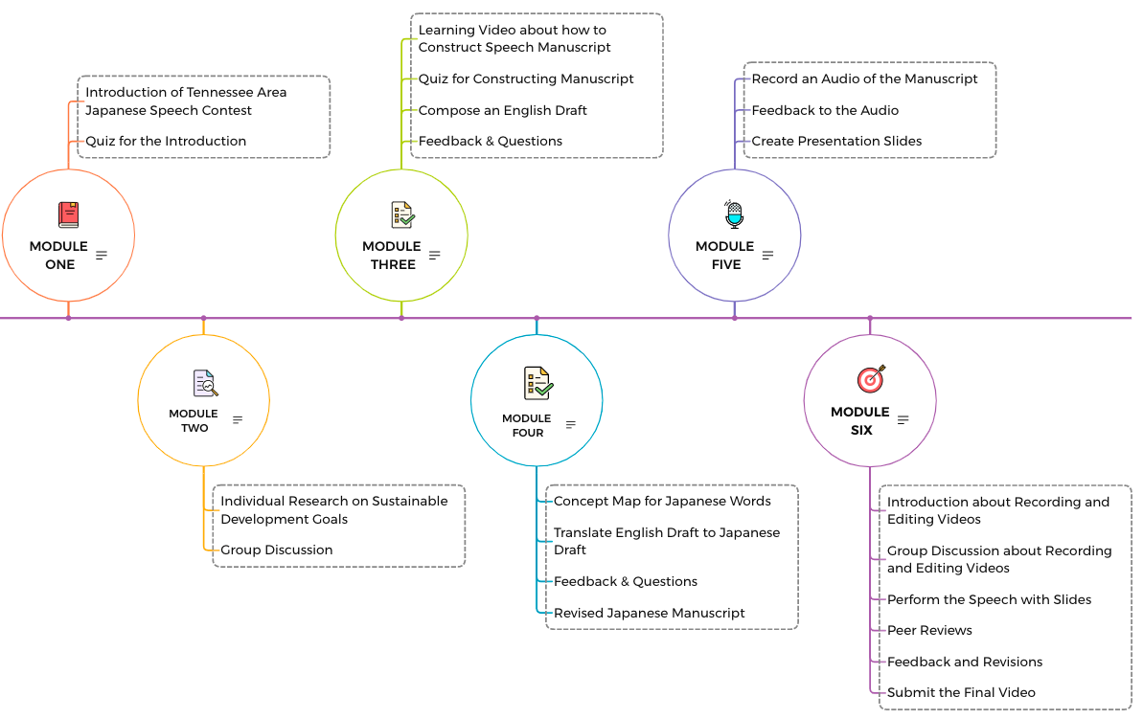
Progression of Instruction

Slide 4


Module 1.0: Introduction
Step 1. Listen to the instruction of Module 1 selecting the audio recording below. You may choose instruction in
English or 日本語.
English
日本語
audio script
This course provides the knowledge and skills to develop and deliver an effective speech in Japanese in the Tennessee Area Japanese Speech Contest held every March, and in fields you will be active in the future.
モジュール１、イントロダクション
みなさん、こんにちは。
コンテストの目的を学習するページにナビゲートされます。
テネシー州日本語スピーチコンテストのためのチュートリアルコースへようこそ。
毎年3月に開催されるテネシー州日本語スピーチコンテストと将来みなさんが活躍する分野において、
日本語で効果的なスピーチを開発し提供するための知識とスキルをこのコースは提供します。
コースのはじめに、テネシー州日本語スピーチコンテストについて詳しく知りましょう。
この音声を聞き終わったら、下のステップ２にあるモジュール1.1のサークル（コンテストの目的）を選んでください。
ナビゲートされたページにある指示にしたがって、学習を進めてください。
Module 1, Introduction
Hello everyone.
Welcome to the tutorial course for the Tennessee Area Japanese Speech Contest.
Learn about the Tennessee Area Japanese Speech Contest at the beginning of the course.
Select the circle of Module 1.1 (the Contest's objectives) in Step 2 below when you have finished listening to this audio.
You will be navigated to a page where you will learn the objectives of the Contest.
Follow the instructions on the guided page to proceed with your learning.
Step 2. Explore the circles below (Module 1.1-1.4) to learn about Tennessee Area Japanese Speech Contest.
Module 1.1 The Contest’s objectives
Module 1.2 Form and requirements
Module 1.3 Time frame of courses
Module 1.4 Registration process
Notes:
Objective & Audience: After reading about the Contest, learners in the Advanced Japanese Language Course at UTK will identify the Contest’s object, form, and requirements. Also, learners will recognize the time frame of the course and the Contest registration process.
Principle illustrated: Shank’s learning strategy 3, chunk content is used to make content easier to understand(P303). Instruction should seek to transfer knowledge to learners in the most efficient, effective manner possible (Table 6.1 Behavioral Theory, P141). Use of media (audio) to motivate by gaining/maintaining Attention (ARCS) & promoting realism (Table 9.8, P237). Use of UDL to provide multiple means of representation(audio) and Action/expression (using modules for student self-pacing) (Table 6.10, P161).

Slide 5
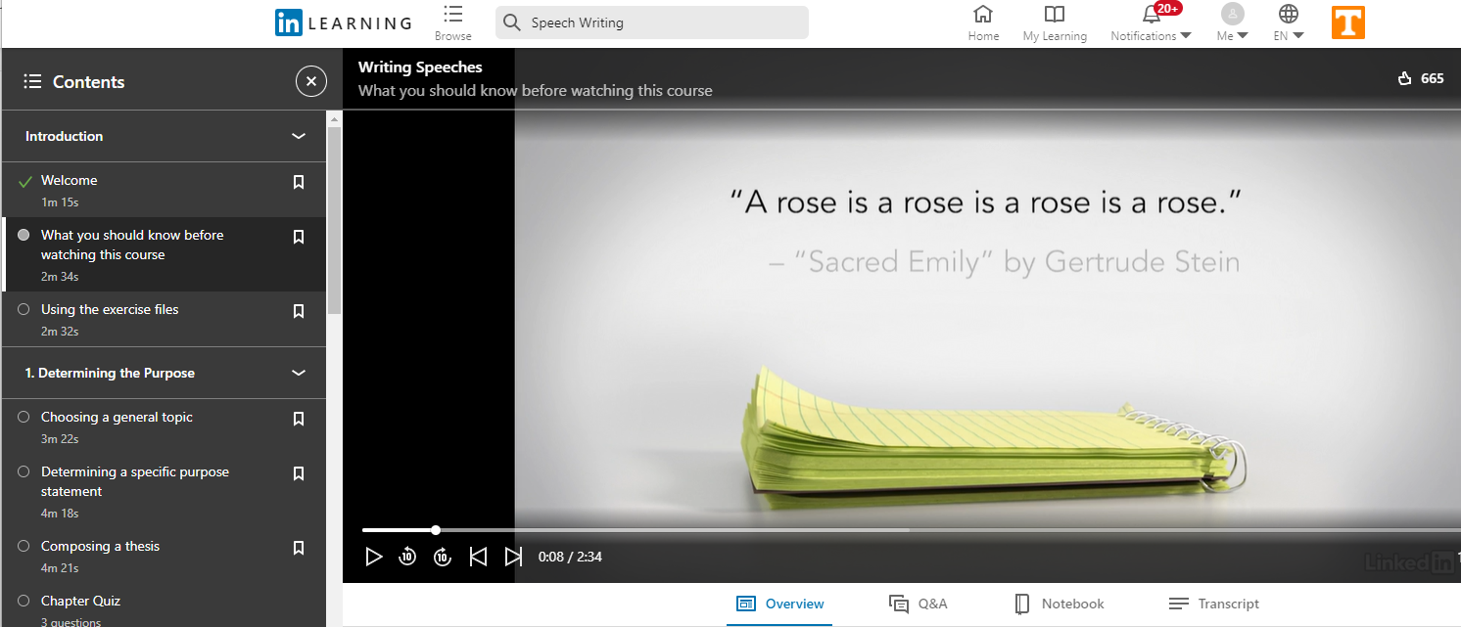
Module 3.0: Writing speech in English
Instruction: Select the image below to watch the video. Or copy and paste the link below to your browser. The video introduces how to write speeches. It shows a general idea to create a manuscript of a speech. This module expects to be basic knowledge of creating a speech draft in English in the next Module of this course. There is a short answer quiz to demonstrate your understanding of the characteristics of speech manuscripts after watching the video.
https://www.linkedin.com/learning/writing-speeches/what-you-should-knhttps://www.linkedin.com/learning/writing-speeches/what-you-should-know-before-watching-this-course?autoAdvance=true&autoSkip=true&autoplay=true&resume=false&u=42574436ow-before-watching-this-course?autoAdvance=true&autoSkip=true&autoplay=true&resume=false&u=42574436
Notes:
Objective & Audience: After watching the video learners in the tutorial for the Japanese speech contest course at UTK will recognize the appropriate steps of writing speeches and the structure of a speech manuscript.
Principle illustrated: Use of media (video) to motivate by gaining/maintaining Attention (ARCS) & promoting realism (Table 9.8, P237). Present the Stimulus (content or learning activity) (Table 9.11 Gagne’s Nine Event, P242). The brain perceives patterns, works by analogy and metaphor, and looks for similarities, differences, and relationships between concepts (Table 6.2 Cognitive Theory, P142). Use of UDL to provide multiple means of representation (Table 6.10 video, P161).

Slide 6
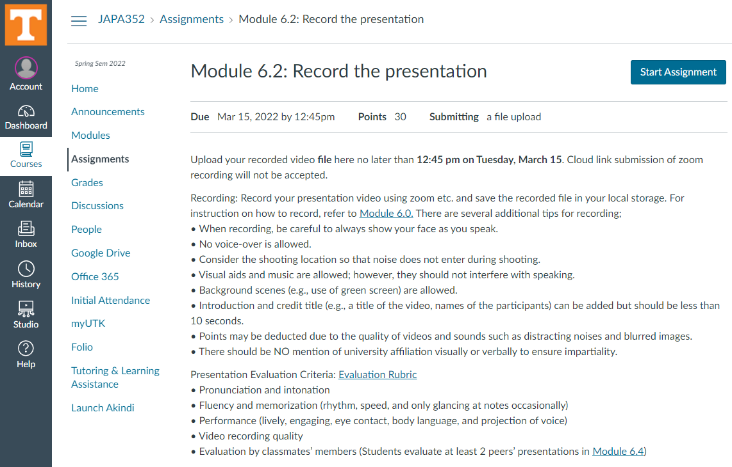
Module 6.2: Record the presentation
Notes:
Objective & Audience: Learners in the tutorial for the Japanese speech contest course at UTK who have reached Module 6.2 have learned how to create Japanese manuscripts for presentations, PPT slides, and record and edit presentations. In this module, the learners perform and video-records the speech presentation.
Principle illustrated: Learners construct their knowledge through a process of active inquiry, enhanced by complexity, authenticity, and experience (Table 6.3 Cognitive Constructivist theory, P144). Schemas and scripts can become automated through practice, placing less load on working memory processing (Table 6.2 Cognitive Theory, P142). Sequencing activities in increasing difficulty with the continual but reasonable challenge to gain leaner’s Confidence (Table 9.8 ARCS, P237).

Slide 7
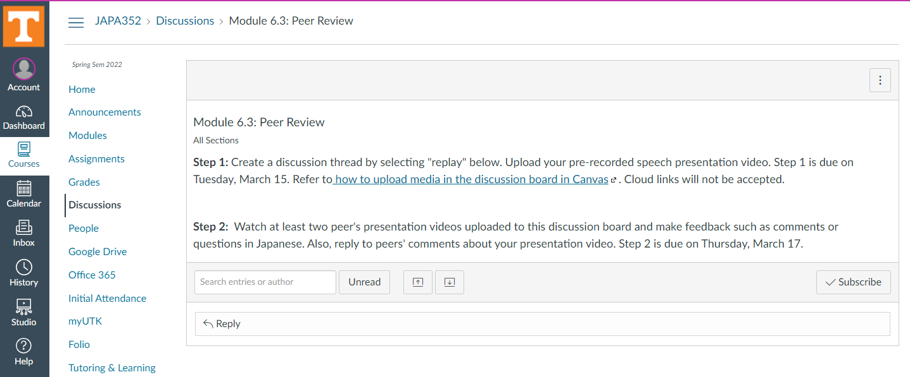
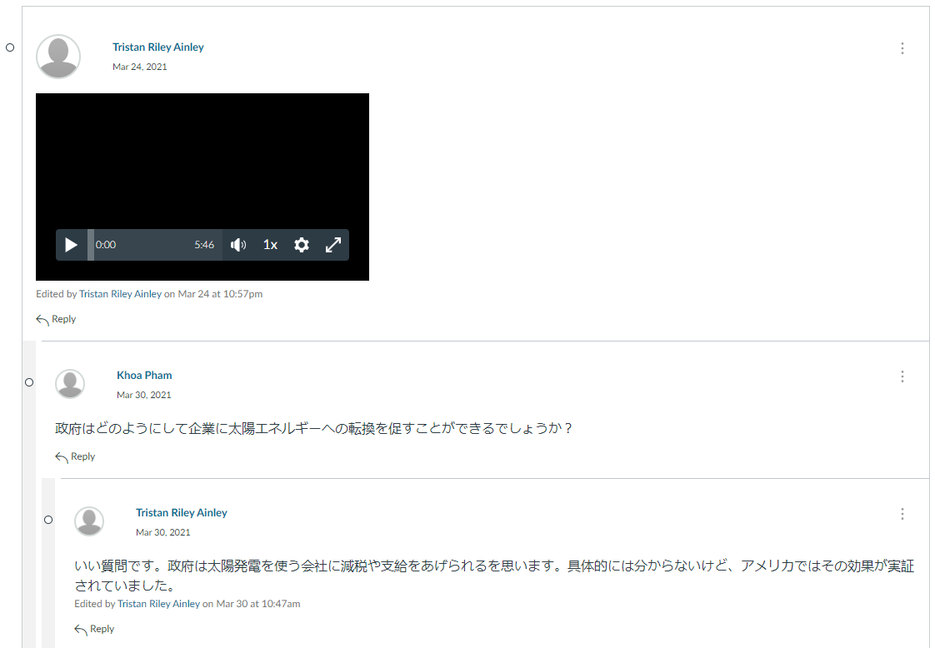
Module 6.3: Peer Review
Notes:
Objective & Audience: In Module 6.3, the learners in the tutorial for the Japanese speech contest course at UTK give and receive feedback to the presentation to reflect improving their speech.
Principle illustrated: Learning is facilitated by effective cues, prompts, and feedback (Table 6.1 Behavioral Theory, P141). Providing immediate feedback to gain satisfaction (ARCS) (Table9.8, P237). Providing prompt and informative feedback to learners to validate/reinforce learning and accurate encoding (Table 11.3 Visual Message Design Principles. P302). Use of UDL to provide multiple means of engagement (Table 6.10 peer feedback, P161).

Slide 8
Audio Script
Module 1, Introduction
Hello everyone. Welcome to the tutorial course for the Tennessee Area Japanese Speech Contest. This course provides the knowledge and skills to develop and deliver an effective speech in Japanese in the Tennessee Area Japanese Speech Contest held every March, and in fields, you will be active in the future.
Learn about the Tennessee Area Japanese Speech Contest at the beginning of the course. Select the circle of Module 1.1 (the Contest's objectives) in Step 2 below when you have finished listening to this audio. You will be navigated to a page where you will learn the objectives of the Contest. Follow the instructions on the guided page to proceed with your learning.
音声スクリプト
モジュール１、イントロダクション
みなさん、こんにちは。テネシー州日本語スピーチコンテストのためのチュートリアルコースへようこそ。毎年3月に開催されるテネシー州日本語スピーチコンテストと将来みなさんが活躍する分野において、日本語で効果的なスピーチを開発し提供するための知識とスキルをこのコースは提供します。
コースのはじめに、テネシー州日本語スピーチコンテストについて詳しく知りましょう。この音声を聞き終わったら、下のステップ２にあるモジュール1.1のサークル（コンテストの目的）を選んでください。コンテストの目的を学習するページにナビゲートされます。ナビゲートされたページにある指示にしたがって、学習を進めてください。
Return
Module 1.1

Slide 9
Module 1: Introduction of the Contest
1.1 the Contest’s objectives
The primary objective of the contest is to encourage the learning and use of the Japanese language in the participants’ community, particularly among non-native speakers. This speech contest represents a fun and challenging way for participants to demonstrate their language and communications skills.
To write a composition that (1) has personally meaningful content and (2) serves as a comprehensive review of the language.
To present a speech with good flow, pronunciation, intonation, and body language.
Next Module

Slide 10
Module 1: Introduction of the Contest
1.2 Form and Rules
Form: Videotaped speech presentation accompanied by PowerPoint slides
Rules:
Contestants may choose any topic that is introduced at UNF Sustainable Development Goals (https://unfoundation.org/what-we-do/issues/sustainable-developmentgoals/).
The presentation needs to be done individually.
Presentation video must be completed within 5 - 6 minutes.
contestants may only apply for ONE DIVISION and ONE LEVEL per contest.
Manuscripts must be original and written by the contestant. Instructors may correct the grammatical mistakes and advise the contestant but may not rewrite the manuscripts.
Sentence structures, grammar, and expressions should be level-appropriate, and should not be all new to the contestants.
There should be NO mention of university affiliation visually or verbally in order to ensure impartiality.
Next Module

Slide 11
Module 1: Introduction of the Contest
1.3 Time frame with milestones of the course
Week 1: (Module 1) Take Quiz A to demonstrate understanding of the Contest.
Week 2: (Module 2) Submit a proposed outline of your speech in English.
Week 3&4: (Module 3) Submit a draft in English.
Week 5&6: (Module 4) Submit a Japanese draft.
February 28: Deadline for registration to the contest
Week 7&8: (Module 5) Create PPT presentation slides.
Week 9&10: (Module 6) Record your presentation and submit it in Canvas.
Week 11: Apply to Tennessee Area Japanese Speech Contest by Friday, March 18.
Next Module

Slide 12
Module 1: Introduction of the Contest
1.4 Process of registration of the Contest
Submit the registration form on Google Form by 5 o'clock (CST) on February 28.
The executive committee will send you an Application Form link based on the appointment form.
Fill out the Application Form with detailed information, the YouTube link by 5 o'clock (CTS) on March 18 (Friday).
Return
Module 3.0

